Slide 1

XYLANASE
Used for bleaching pulp in paper industry
By Asmit Samanta
(COMPS)
D-06

Slide 2

CONTENTS
01. Introduction
02. Objectives
03. Industrial Application
04. Products made using Xylanase
05. Role of Computer Engineer
06. References

Slide 3
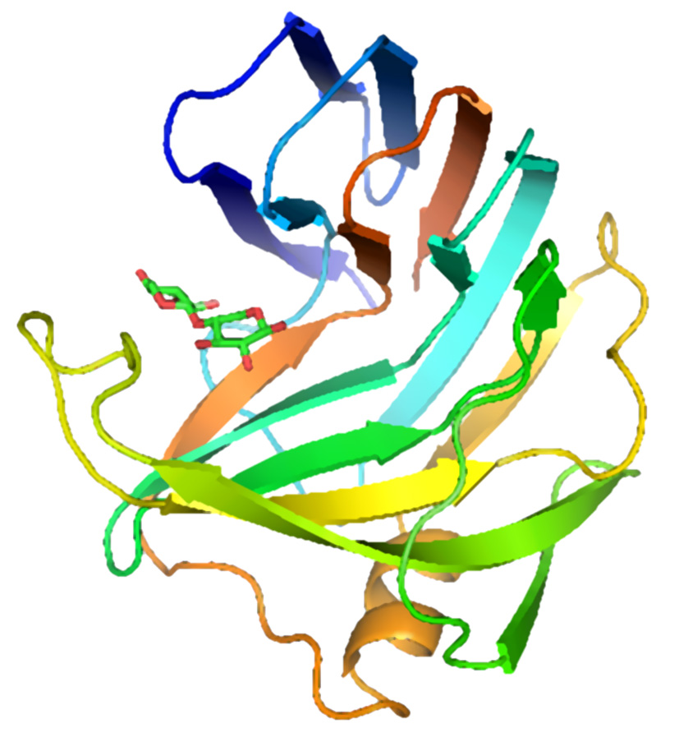
INTRODUCTION
Xylanase
Xylanase is an enzyme that specifically targets and breaks down Xylan, a major component of plant cell walls.
It hydrolyses the xylan component of the biomass and its activity can be evaluated by its impact on xylan serving as the substrate.
Xylanase production has been reported from various microorganisms including bacteria, fungi, and actinomycetes, and can be produced using both prokaryotes and eukaryotes such as bacteria, cyanobacteria, yeast, and fungi.
Structure of Xylanase
Reference : Taylor & Francis
Source: Xylanase 3D Structure

Slide 4
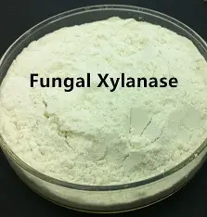
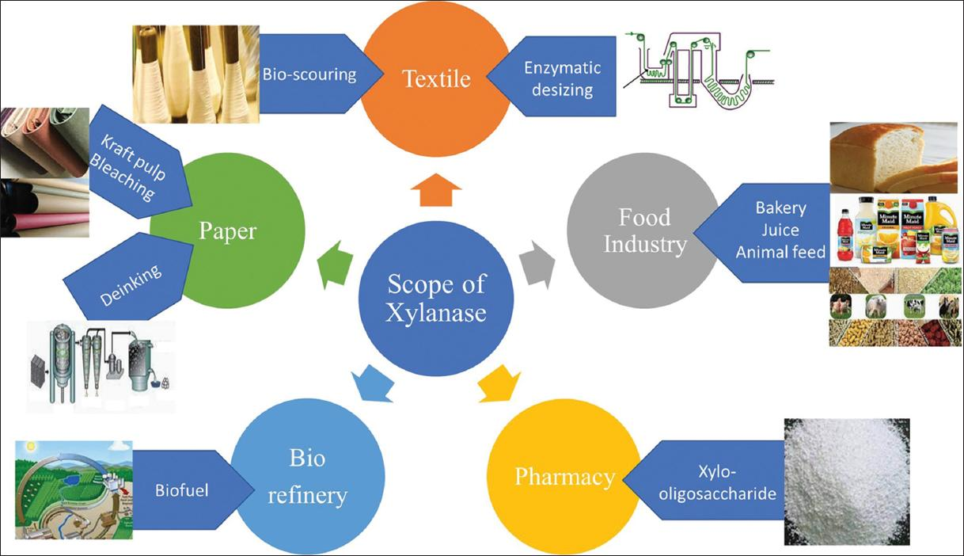
OBJECTIVES
Xylanase’s main objective is to breakdown Xylan for using plant based raw materials in industries.
Microbial xylanase is suitable for applications in food and feed, paper and pulp, textile, pharmaceutical, and biorefining industries.
It has gained global attention due to its substrate specificities, biochemical properties, and various biotechnological applications.
Source: Scope of Xylanase
Source: Fungal Xylanase

Slide 5
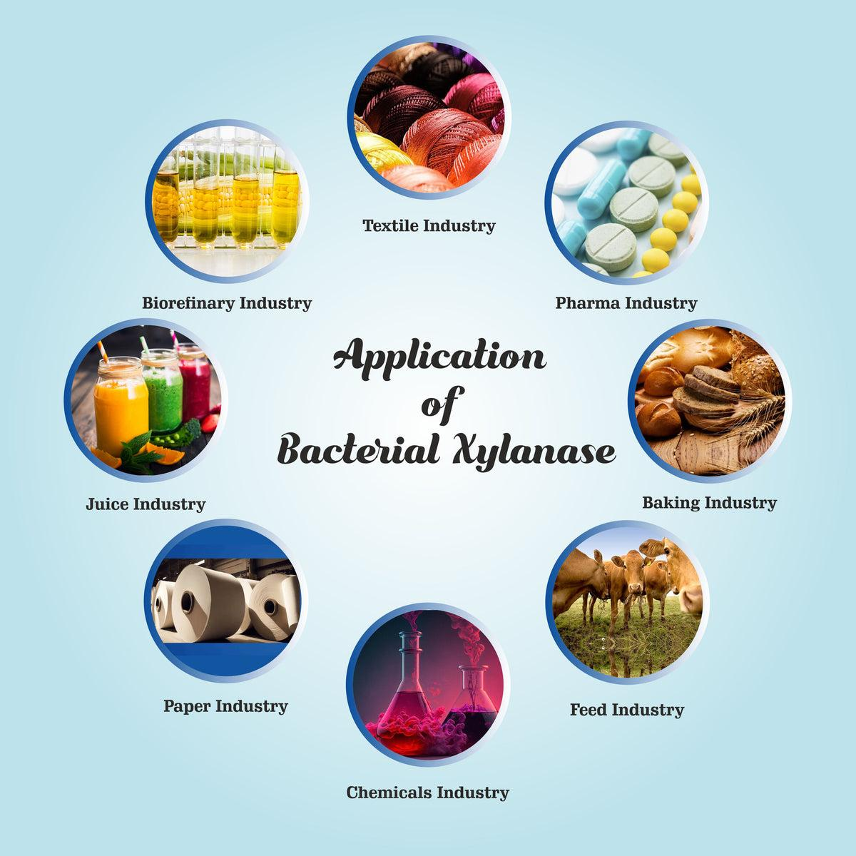
INDUSTRIAL APPLICATION
The pulp and paper industry uses chlorine for bleaching purposes. The bleaching process results in the creation of organochlorine compounds. These are generated by the reactions between chlorine and residual lignin present in wood fibers.
Many of these compounds harm the environment as they are mutagenic, toxic, persistent, and bioaccumulating. The discharge of wastewater containing these compounds into water bodies results in the elimination of aquatic species, pollution of potable water, and accumulation of toxins in the body of fishes.
Due to these factors, the industry has to face certain limits and restrictions on the discharge of these compounds. To solve this problem, xylanase enzymes can be used in the pulp bleaching process which works both for woody pulps and non-woody pulps made from fibers like jute, wheat straw, and rice straw.
This process is known as ‘bio-bleaching’ helps prevent the production of organochlorine compounds.
Source: Application of Xylanase
Reference: infinabiotech.com

Slide 6
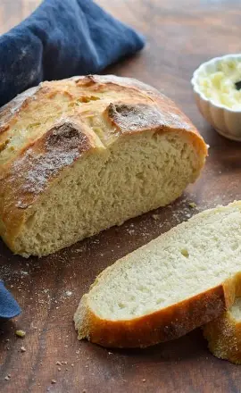
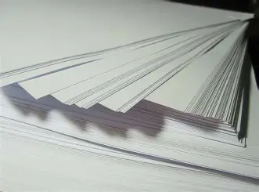
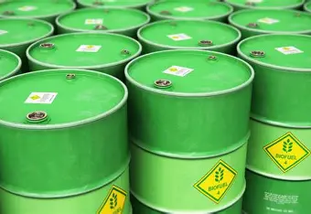
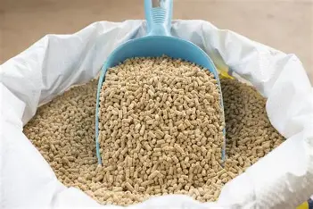
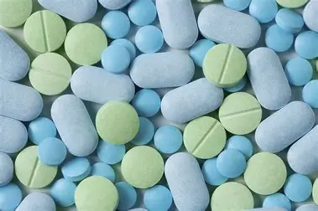
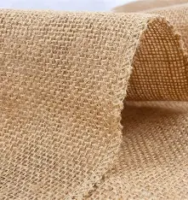
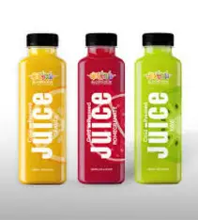
PRODUCTS MADE BY USING XYLANASE
Source: Image1
Source: Image2
Source: Image3
Source: Image4
Source: Image5
Source: Image6
Source: Image7

Slide 7
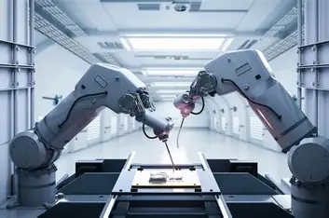
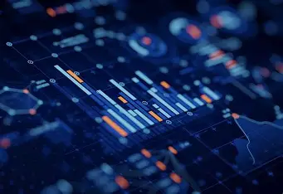


ROLE OF COMPUTER ENGINEERING
Automation
Create software that tracks enzyme activity in real time.
Data Analysis
Examine product’s quality, and efficiency using machine learning.
Process modelling
To maximize yield and efficiency, model the activity of enzymes.
IoT Integration
AI and sensors for automated production of products.

Slide 8
REFERENCE
Information:
https://taylorandfrancis.com/knowledge/Engineering_and_technology/Chemical_engineering/Xylanase
https://www.intechopen.com/chapters/71830
https://infinitabiotech.com/blog/xylanase-enzyme-in-pulp-paper-industry/#:~:text=To%20solve%20this%20problem%2C%20xylanase%20enzymes%20can%20be,%E2%80%98bio-bleaching%E2%80%99%20helps%20prevent%20the%20production%20of%20organochlorine%20compounds.
Images:
https://sites.ffclrp.usp.br/pbbg/english/research/xylanase/xylanase_structure.htm
https://jabonline.in/jab_demo/ckfinder/images/JABB-11-2-41-g006.jpg
https://inrorwxhkokklm5p.ldycdn.com/cloud/jpBpkKpkljSRrkpqnpprjq/Fungal-Xylanase-640-640.jpg
https://th.bing.com/th/id/R.f2ca17574a6be2772a67e96074d17c92?rik=Sf8WZWZtzqxuiQ&riu=http%3a%2f%2fonlineingredient.com%2fcdn%2fshop%2ffiles%2fApplicationofBacterialXylanaseEnzyme-BiovenIngredients_1200x1200.jpg%3fv%3d1718875164&ehk=fGIy77g4uoYMcZ54MgaOKZvVlz5WdJDkhjZssfRm1L0%3d&risl=&pid=ImgRaw&r=0
https://www.onceuponachef.com/images/2020/03/Crusty-Bread-1200x1553.jpg
https://cdn.zeebiz.com/sites/default/files/2018/12/07/63235-paper-pixabay.jpg
https://th.bing.com/th/id/OIP.UnIzEhuHV3QMEziNfQ8lgHaE8?w=262&h=180&c=7&r=0&o=7&dpr=1.3&pid=1.7&rm=3
https://th.bing.com/th/id/OIP.G_al0L7auiLLmmZQgwljVQHaE8?w=270&h=180&c=7&r=0&o=7&dpr=1.3&pid=1.7&rm=3
https://www.verywellhealth.com/thmb/P8mUyyzJ9ERP57K7_7COb8iSAhc=/1500x0/filters:no_upscale():max_bytes(150000):strip_icc()/GettyImages-186846700-56a05f193df78cafdaa14c87.jpg
https://i.etsystatic.com/19319752/r/il/e8bbf6/4097387117/il_fullxfull.4097387117_f8tr.jpg
https://tiimg.tistatic.com/fp/1/007/364/fruit-juice-without-added-preservative-and-artificial-flavour-661.jpg
https://tse3.mm.bing.net/th/id/OIP.3406cPhjQcmQLtytgJnlrAHaEK?rs=1&pid=ImgDetMain&o=7&rm=3
https://assets.datamation.com/uploads/2024/01/dm_20240102-types-of-data-analytics.png
https://www.maxzosim.com/content/images/size/w1200/2023/03/Process-Modelling-logo.jpeg
https://tse4.mm.bing.net/th/id/OIP.M-af86xBinB142heC6iR-AHaEK?rs=1&pid=ImgDetMain&o=7&rm=3

